Slide 1
Digital
Portfolio
STUDENT NAME: MONISH KUMAR P
REGISTER NO AND NMID :
8B6B3A9A7EC15ACB88C4796F83B995DB
DEPARTMENT:B.C.A
COLLEGE: COLLEGE/ UNIVERSITY S.A COLLEGE OF
ARTS $ SCIENCE/MADRAS UNIVERSITY
1

Slide 2
PROJECT TITLE:
“CURRENT ACADEMIC PORFOLIO”
*Current Academic portfolio using HTML, CSS, and
Javascript.
*Digital portfolio of current academic records
*Personal Academic portfolio-Devika.A
2

Slide 3
AGENDA
1. Problem Statement
2. Project Overview
3. End Users
4. Tools and Technologies
5. Portfolio design and
Layout
6. Features and
Functionality
7. Results and Screenshots
8. Conclusion
9. Github Link
3

Slide 4
PROBLEM STATEMENT
In today’s digital world, students often struggle to present their academic achievements,
skills, and certifications in an organized and professional way. Traditional paper-based
resumes and certificates are not interactive and can easily be misplaced. Moreover, they do
not effectively highlight a student’s overall profile, including projects and personal goals.
Therefore, there is a need for a digital academic portfolio where students can showcase their
education, skills, certifications, and projects in one place. This portfolio should be easily
accessible, visually appealing, and interactive so that it can be shared with teachers,
recruiters, and peers as proof of academic and personal development.
4

Slide 5
PROJECT OVERVIEW:
The Current Academic Portfolio is a web-based application developed using HTML, CSS, and JavaScript. It
serves as a digital resume for students, allowing them to present their academic achievements, skills,
certifications, and projects in an interactive and professional manner.
The portfolio is divided into multiple sections such as:
About Me – A brief introduction of the student.
Education – Academic qualifications.
Skills – Technical and professional skills.
Certificates – Achievements and certifications.
Projects – Mini/major projects completed.
Contact – A form to reach the student.
This project provides an organized, accessible, and visually appealing platform for students to showcase their
profile, making it useful for internships, job opportunities, and academic purpose.
5

Slide 6
WHO ARE THE END
USERS?
1. Students
* To showcase their academic achievements, skills, certificates, and projects.
*To use as a digital resume for internships and job applications.
2. Teachers / Mentors
* To evaluate a student’s academic progress, skills, and project work.
* To guide students in improving their professional profile.
3. Recruiters / Employers
* To easily view the student’s qualifications, skills, and certifications.
* To assess suitability for internships or job opportunities.
4. Peers / Academic Institutions
* To collaborate, share achievements, and maintain digital academic records.
6

Slide 7
TOOLS AND TECHNIQUES
Visual Studio Code (VS Code) – For coding and editing the project.
Web Browser (Google Chrome/Edge/Firefox) – For testing and running the portfolio.
GitHub / Localhost – For hosting and deployment .
MS PowerPoint / Canva – For preparing project documentation and presentations.
TechnologiesHTML5 – For structuring the web pages.
CSS3 – For styling, layouts, and responsive design.
JavaScript – For adding interactivity and form validation.
7

Slide 8
POTFOLIO DESIGN AND LAYOUT
 1. Header & Navigation Bar
Positioned at the top of the page.
Contains the portfolio title (Student Name) and navigation links.
Links allow smooth scrolling to different sections: About, Education, Skills, Certificates,
Projects, and Contact.
Background color: Green (#4CAF50) for professional appearance.
 2. About Section
Provides a short introduction of the student.
Includes name, course (BCA), and ambition (to become a cloud professional)
 3. Education Section
Displays academic qualifications in a list format.
Covers current and past education (BCA, 12th, 10th).Organized clearly for easy
understanding.
8

Slide 9
 4. Skills Section
Skills are displayed in a grid-based card layout.
Each card contains one skill (HTML, CSS, JavaScript, Python, cloud computing,AI, DCA)
Hover effect is applied for interactivity
 5. Certificates Section
Highlights completed certifications in a card format. Each card has a certificate name and a short description. Examples: AI, UI & UX Design, DCA
 6. Projects Section
Lists mini/major projects completed.
Each project is shown in a card style with project name and short description.
Example: Portfolio Website, Library Management System

Slide 10
 7. Contact Section
Includes a contact form with Name, Email, and Message fields.
Uses JavaScript validation to check inputs before submission.
Provides an easy way for recruiters/teachers to reach the student.
 8. Footer
Placed at the bottom of the page.
Contains copyright info (© 2025 MONISH KUMAR P| Student Portfolio).
Styled with a dark background for contrast.
 Design Principles Followed
Responsive Design – Works on desktop, tablet, and mobile.
Minimal & Professional Look – Simple fonts and clean color scheme.
Interactive Elements – Hover effects, smooth navigation, form validation.
Organized Layout – Sections divided clearly for easy navigation.

Slide 11

FEATURES AND FUNCTIONALITY
 Features
1.Single Page Portfolio – All student details are displayed on a single page with
smooth navigation.
2. Responsive Design – Works well on desktop, tablet, and mobile devices.
3. Clean UI & Layout – Simple, card-based design for skills, certificates, and
projects.
4. Interactive Elements – Hover effects on cards, smooth scrolling navigation.
5. Contact Form – Allows visitors to send messages to the student.
6. Organized Sections – About, Education, Skills, Certificates, Projects, and
Contact are clearly separated.
7. Custom Styling – Consistent color theme (green & white) for a
professional look.

Slide 12
 Functionality
1. Navigation Bar – Links to different sections on the page.
2. About Section – Displays student introduction and ambition.
3. Education Section – Shows academic qualifications.
4. Skills Section – Lists technical/professional skills in card format.
5. Certificates Section – Highlights student certifications with
details.
6. Projects Section – Displays mini/major projects with
descriptions.
7. Contact Section –Input fields: Name, Email, Message.JavaScript
validation checks for empty fields before submission.
Confirmation alert is shown on successful submission.

Slide 13
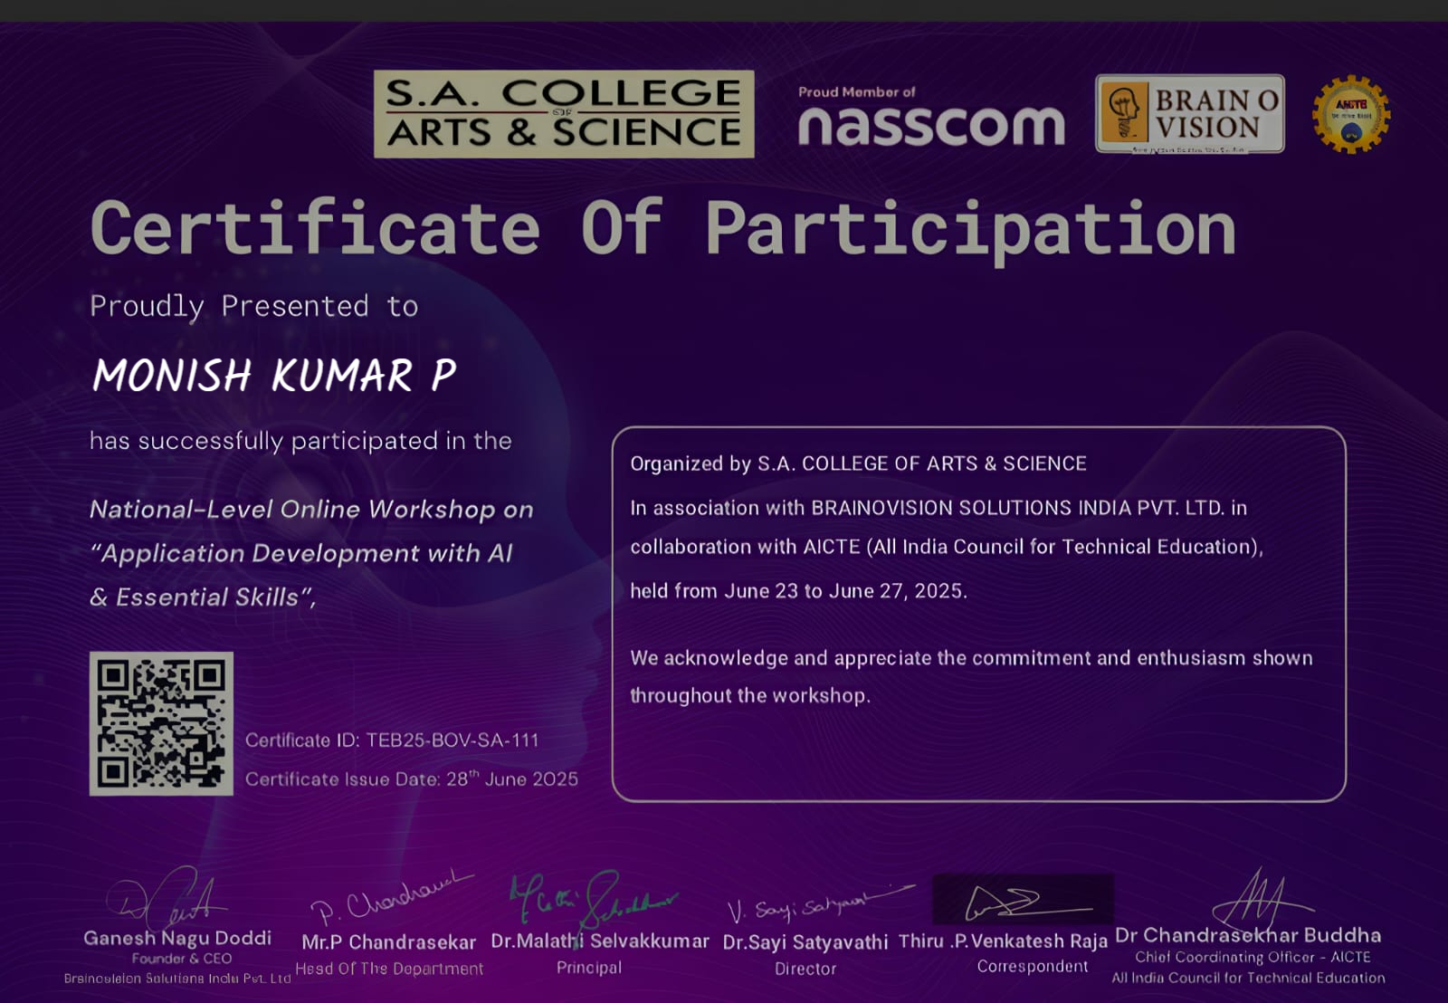
APPLICATION DEVELOPMENT WITH AI :

Slide 14
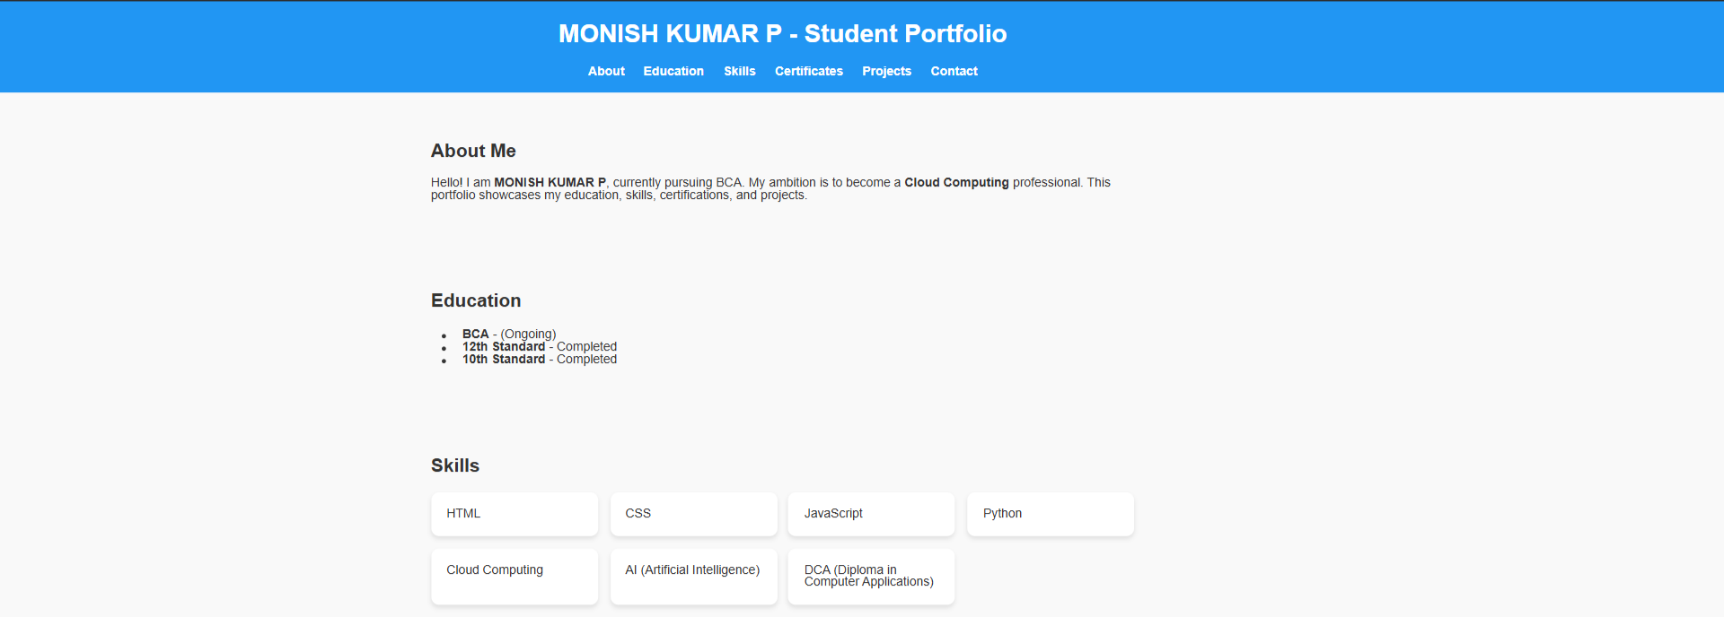
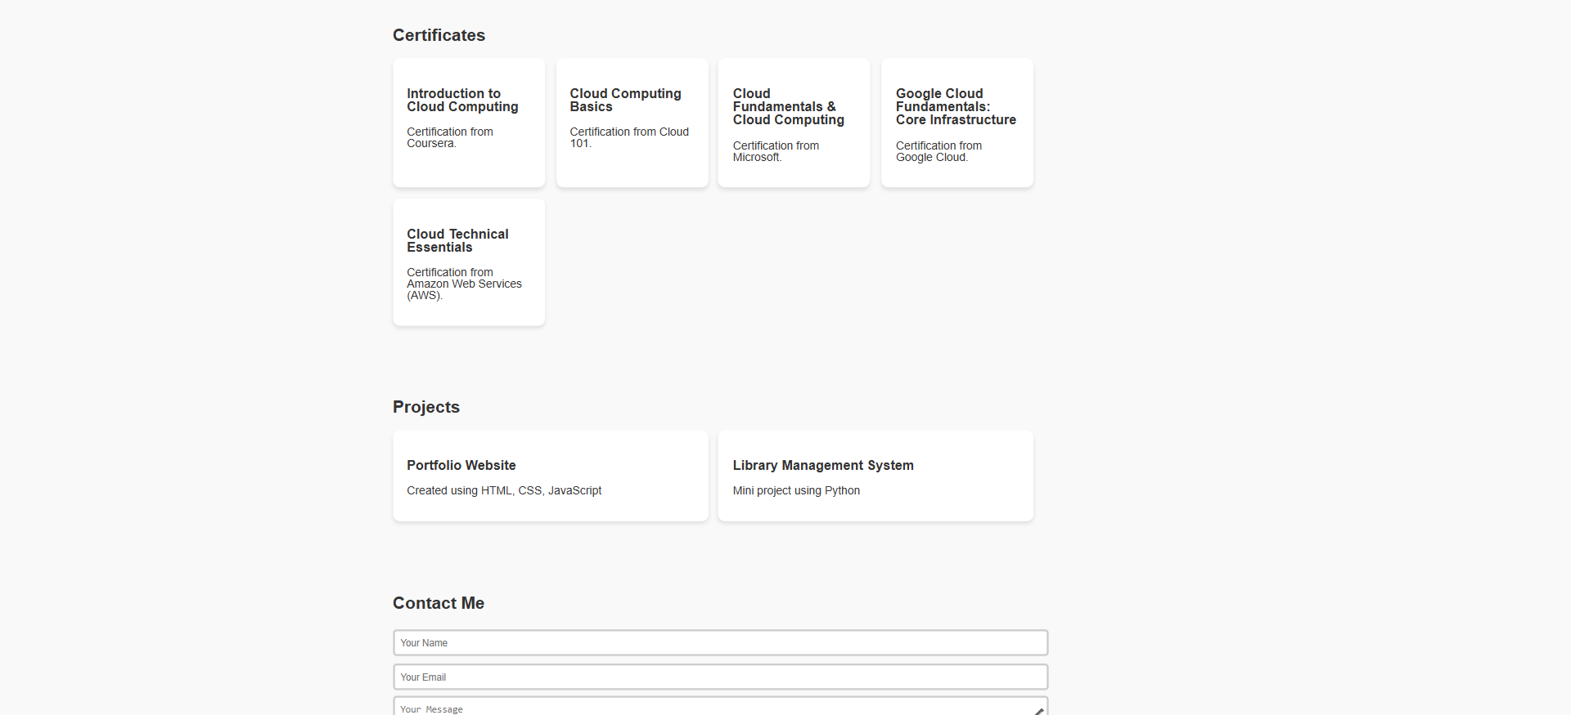
RESULTS AND SCREENSHOTS
18

Slide 15
CONCLUSION:
The Current Academic Portfolio project successfully demonstrates how
students can digitally showcase their academic qualifications, skills,
certifications, and projects in a structured and professional way. Unlike
traditional paper-based resumes, this portfolio is interactive,
responsive, and easily accessible online, making it more effective for
academic purposes, internships, and job opportunities.
By using HTML, CSS, and JavaScript, the project provides a simple yet
modern platform where students can highlight their strengths and
achievements. This enhances their chances of being recognized by
teachers, recruiters, and peers.
In conclusion, the project proves that digital portfolios are an essential
tool for today’s students, enabling them to present themselves in a
professional manner and stand out in the competitive world
.
19

